Slide 1
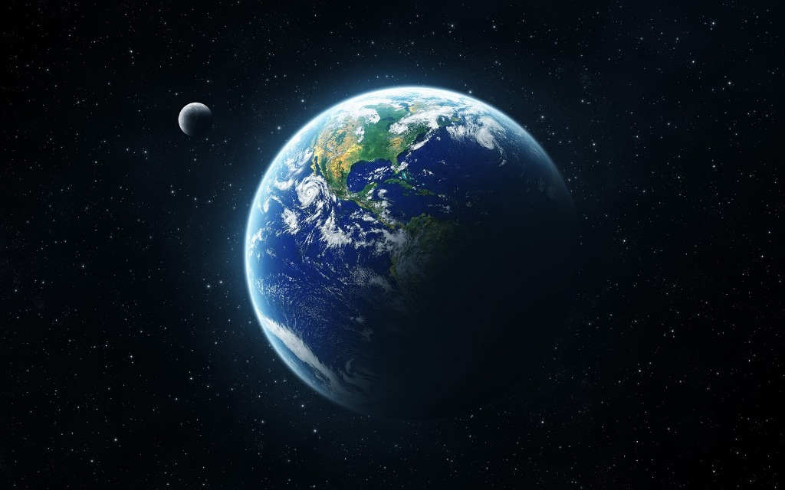
Physical Geography of Earth

Slide 2
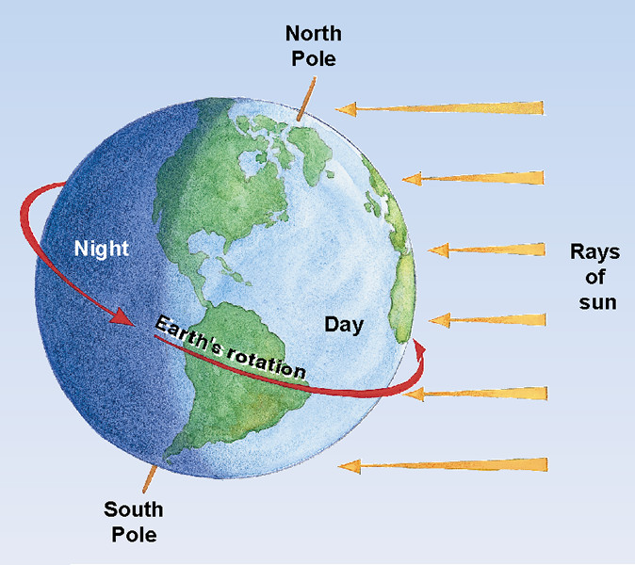
Day and Night
The Earth travels around the sun in an oval-shaped orbit
It takes 365 ¼ days for the Earth to make one complete revolution around the sun

Slide 3

As the Earth revolves, it is also spinning on its axis
Each rotation takes about 24 hours

Slide 4
Why are the days longer in some parts of the year?
The Earth’s axis is at an angle.
In about half of the Earth’s orbit, the tilt causes a region to face toward the sun for more hours than it faces away from the sun
Days are longer
In other regions that face away from the sun for more hours, days are shorter

Slide 5
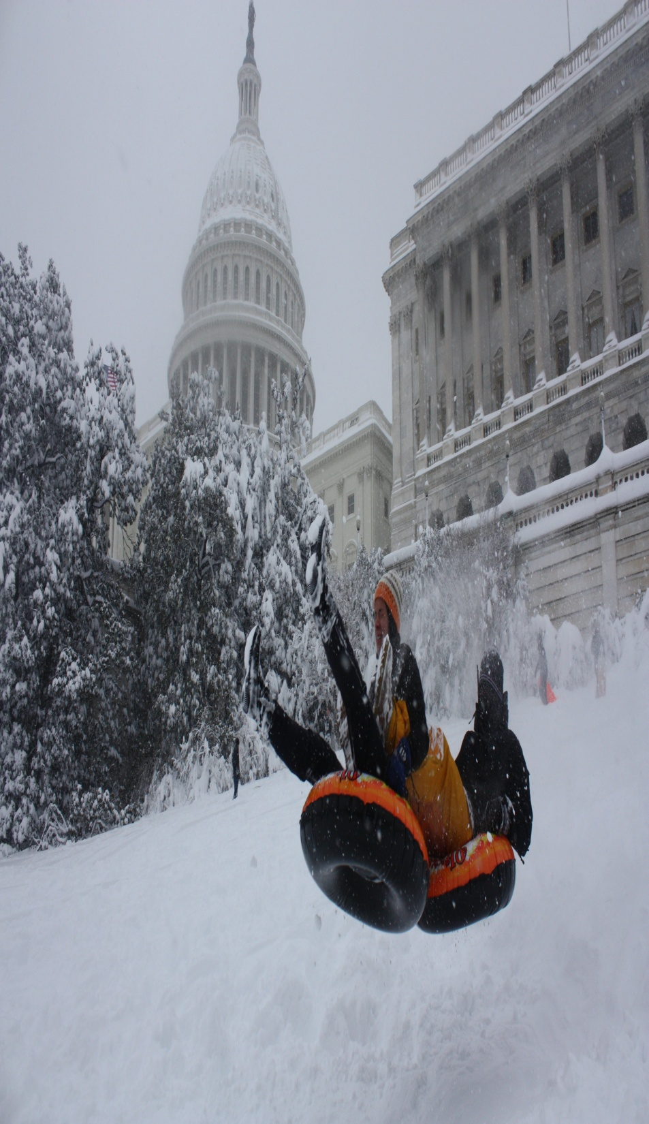
Why does the temperature change during the seasons?
The warmth you feel at any given time of year depends on how directly the sunlight falls on you
This is also a result of the Earth’s tilt and orbit

Slide 6
Looking at Latitudes
Gets Direct Sunshine on
Line of Latitude
Where is it?
Seasons
Equator
0º
March 21
September 23
Spring and fall equinoxes: Days and nights are almost equal everywhere
Tropic of Cancer
23 1/2º N
June 21
Tropic of Capricorn
23 1/2º S
December 21
First day of winter, or winter solstice, in Northern Hemisphere
Arctic Circle
66 1/2º N
Never
Antarctic Circle
66 1/2º S
Never

Slide 7
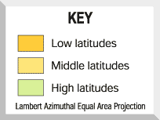
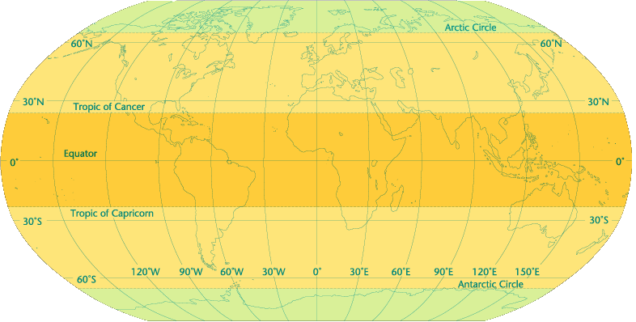
Zones of Latitudes

Slide 8
Looking at Latitudes: Zones
Low Latitudes: The Tropics
Area between the Tropic of Cancer and the Tropic of Capricorn
In this region, it is almost always hot

Slide 9
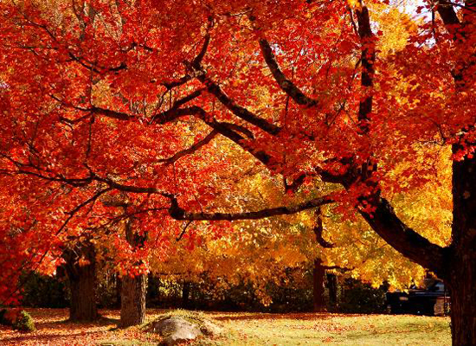
Middle Latitudes: The Temperate Zones
Area between the Tropic of Cancer and the Arctic Circle
AND the area between the Tropic of Capricorn and the Antarctic Circle
In this region, there are seasons, each with a distinct pattern of daylight, temperature, and weather

Slide 10
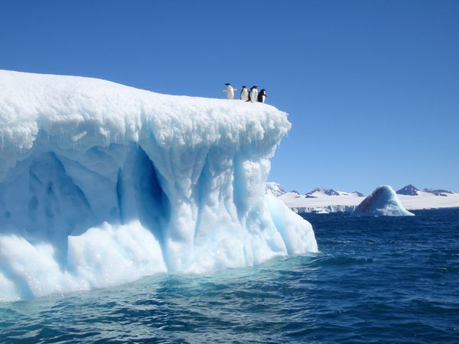
High Latitudes: The Polar Zones
Area between the Arctic Circle and the North Pole
AND the area between the Antarctic Circle and the South Pole
In this region it is very cool to bitterly cold

Slide 11
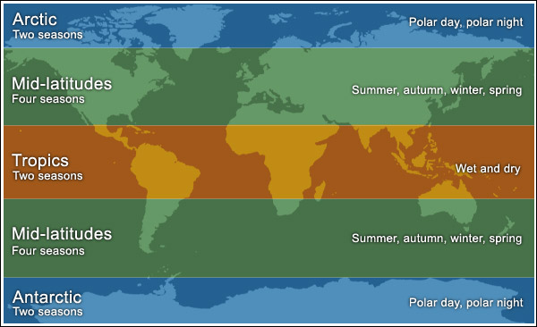

Slide 12
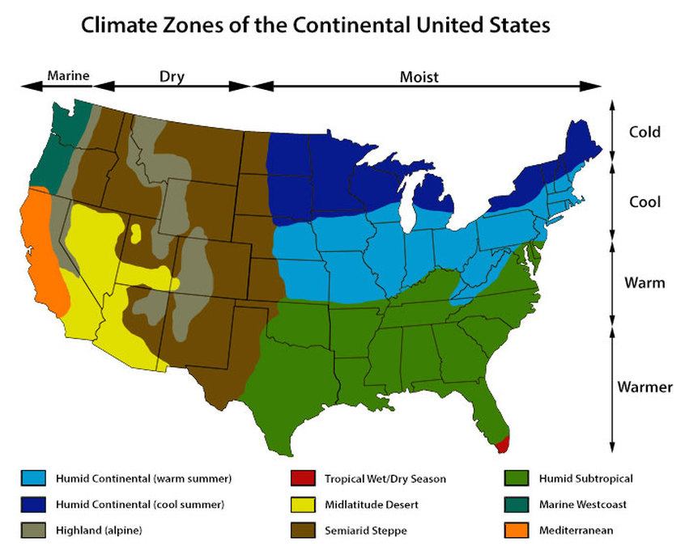

Slide 13
Dangerous Storms
Wind and water can make climates milder, but they also can create storms. Some storms create great destruction

Slide 14
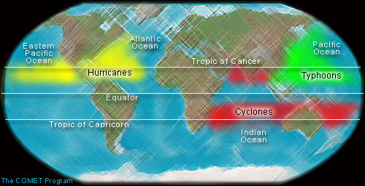

Slide 15
Hurricanes
Wind and rain storms that form in the tropics in the Atlantic Ocean
They produce huge waves called storm surges, which flood over shorelines and can destroy homes and towns

Slide 16
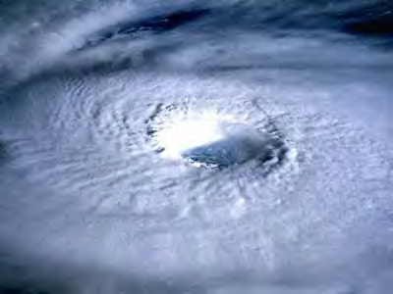
Typhoons
  Similar to hurricanes, they take place in the Pacific Ocean

Slide 17
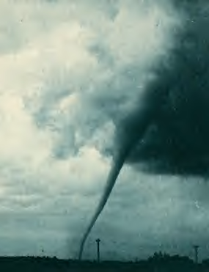
Tornadoes
Swirling funnels of wind that can reach 200 miles per hour
The powerful winds can wreck almost anything in a tornado’s path
However, they only average about one half mile in diameter
Therefore they affect a more limited area than hurricanes

Slide 18
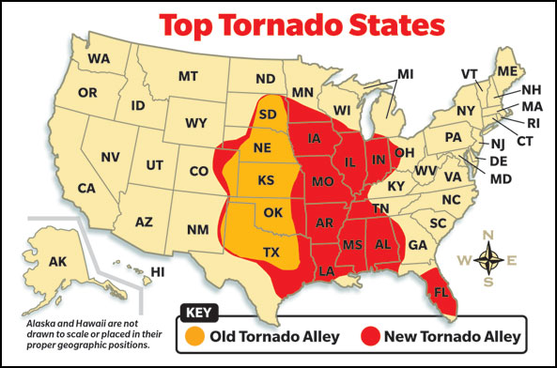

Slide 19
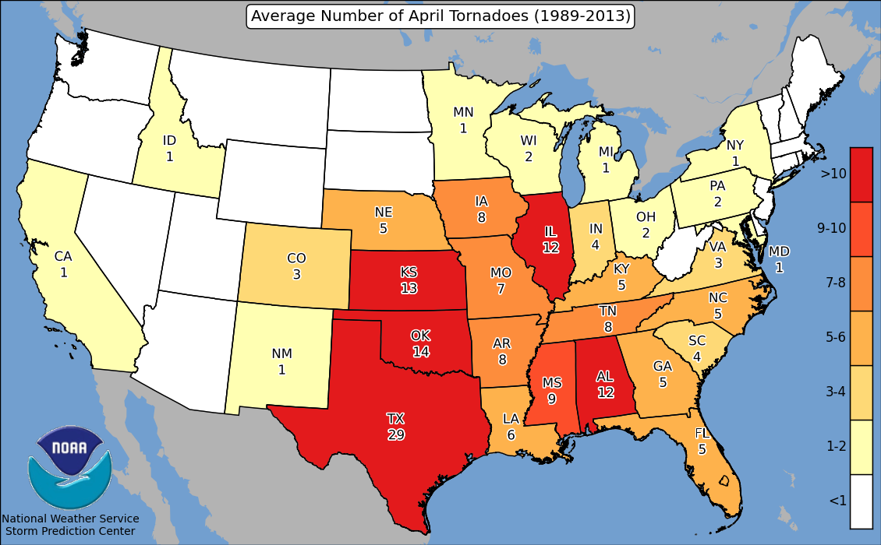

Slide 20
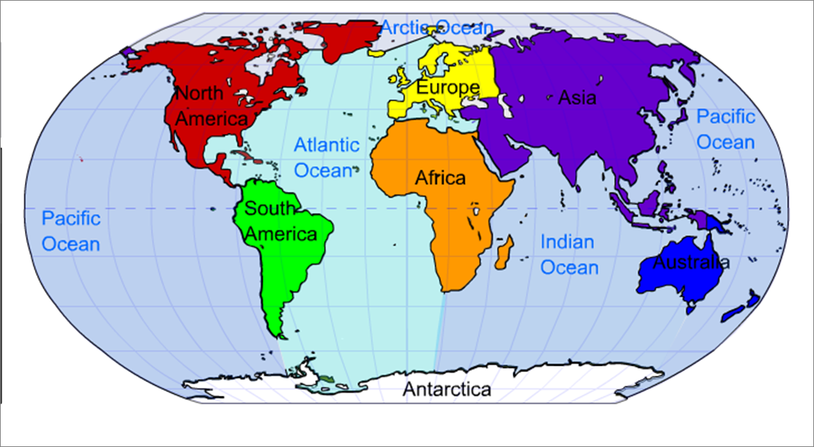

Slide 21
Nebraska Counties
Most Populated Least Populated
1 – Douglas – 517,110 1 – Arthur – 478
2 – Lancaster – 285,407 2 – McPherson – 504
3 – Sarpy – 158,840 3 – Blaine – 514
4 – Hall – 58,607 4 – Loup - 592
5 – Buffalo – 46,102 5 – Grant - 628

Slide 22
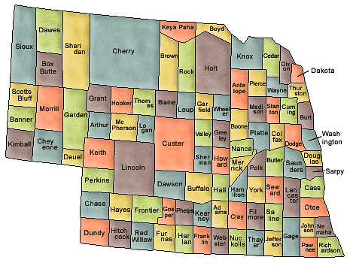

Slide 23
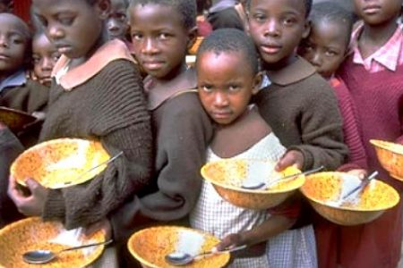
Free Rice

