Slide 1
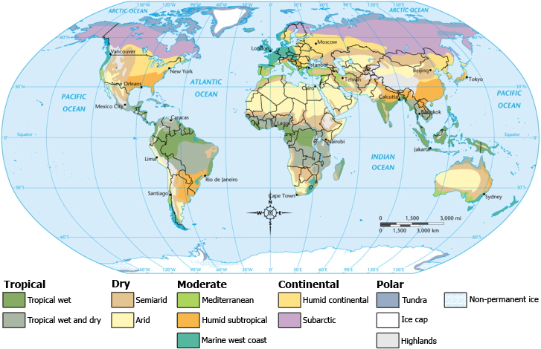
V. Types of Climates

Slide 2
A. Climate Regions
Patterns of temperature, precipitation, and wind create world climate regions
Climate Regions- Areas that share a similar climate

Slide 3
B. Ecosystems
Ecosystem – Group of plants and animals that depend on each other and their environment for survival
Ecosystems can change over time due to physical processes or human activity

Slide 4
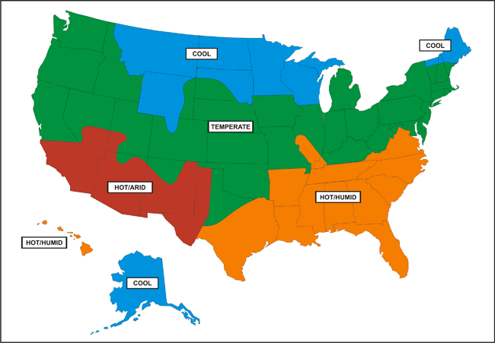

Slide 5
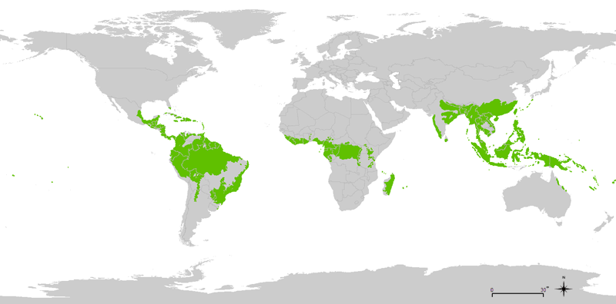
Tropical Wet – Climates that combine hot temperatures and heavy rainfall year round and are clustered around the Equator – Tropical rainforests

Slide 6
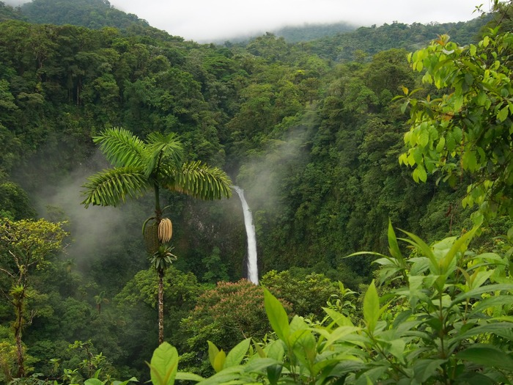

Slide 7
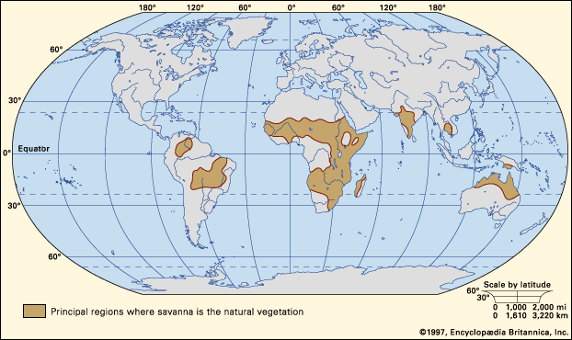
Tropical Wet and Dry – Climates with wet season in summer and dry season in winter
Savanna - Grasslands with scattered trees that can survive dry spells

Slide 8
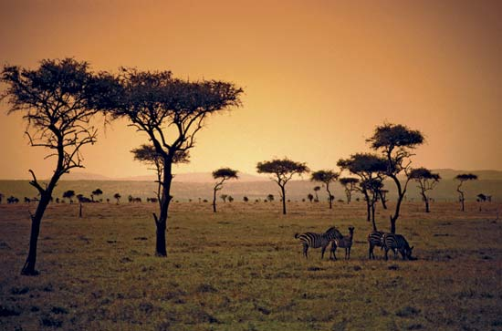

Slide 9
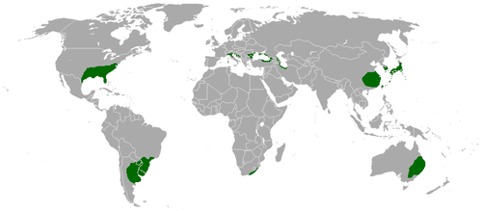
Humid Subtropical – Climates have year-round precipitation with mild winters and hot summers

Slide 10
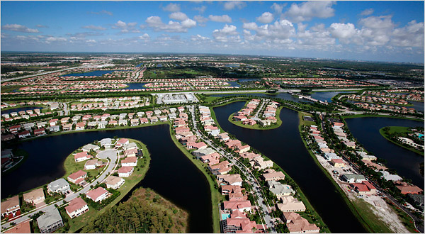

Slide 11
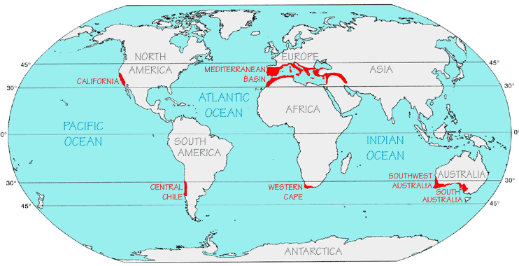
Mediterranean – Climates that have hot, dry weather in the summer and a rainy season in the winter

Slide 12
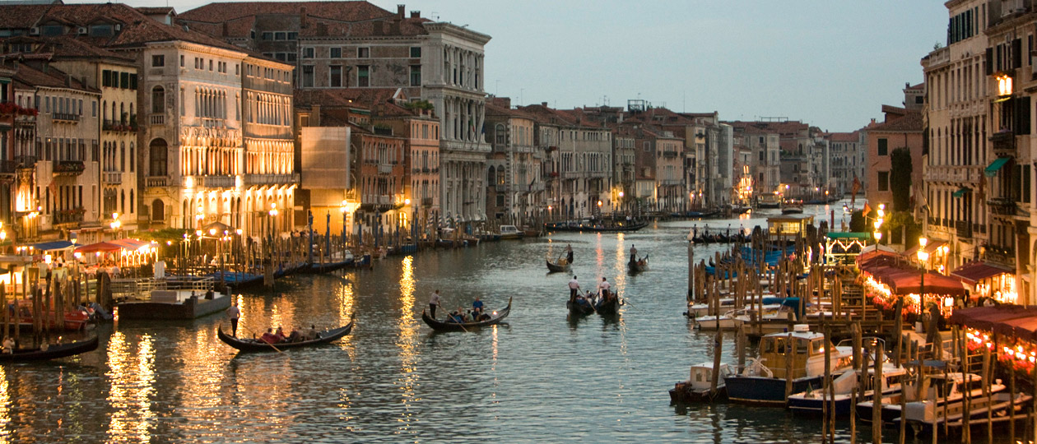

Slide 13
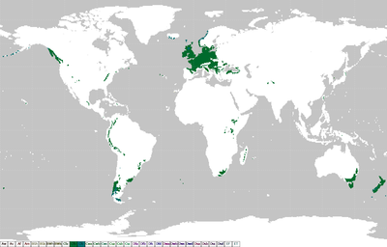
Maritime – Climates are wet year-round, with mild winters and cool summers
They exist where moist winds blow onshore

Slide 14
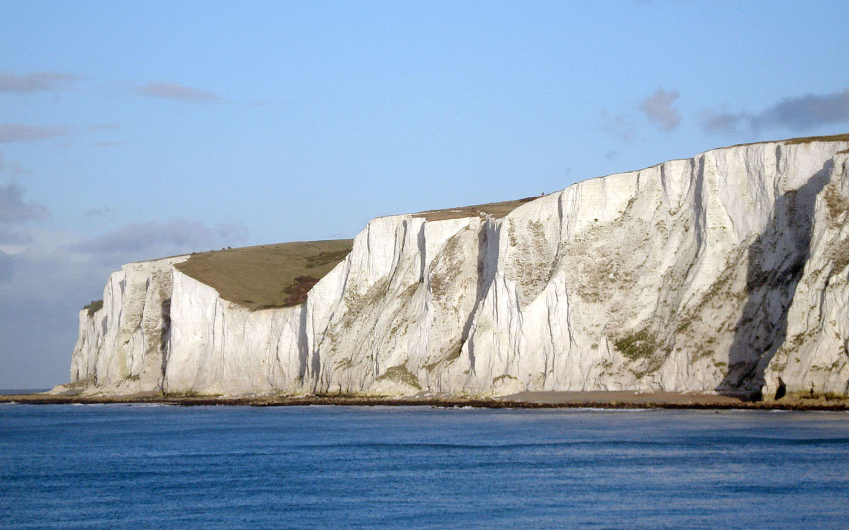

Slide 15
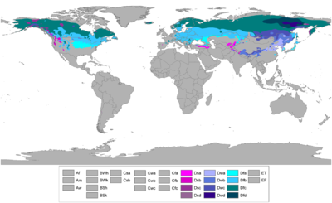
Continental – Have year-round precipitation, warm summers, and cold, snowy winters
Deciduous Forests – Tree that lose their leaves in the fall

Slide 16
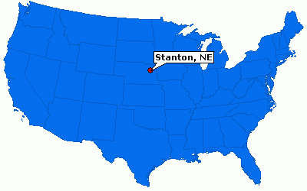

Slide 17
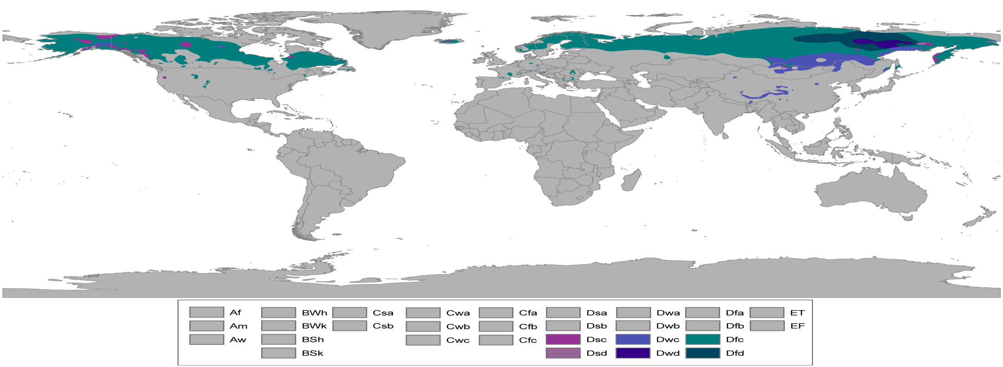
Subarctic – Have limited precipitation, cool summers, and very cold winters
Coniferous Forests – Tree that produce cones and carry seeds

Slide 18
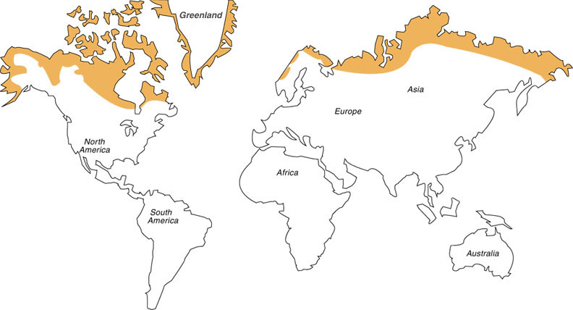
Tundra – Have cool summers and bitterly cold, dry winters
Close to the poles, ice caps, or permanent sheets of ice covering land or sea

Slide 19
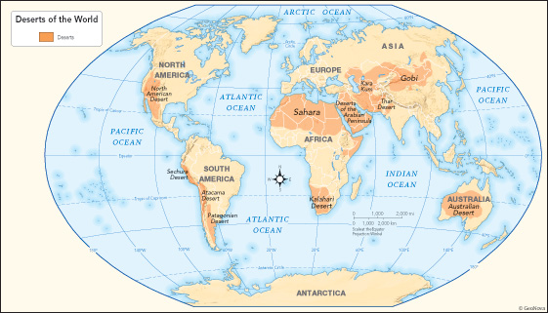
Arid – Extremely dry areas - deserts
Occur where there is steadily sinking air

Slide 20
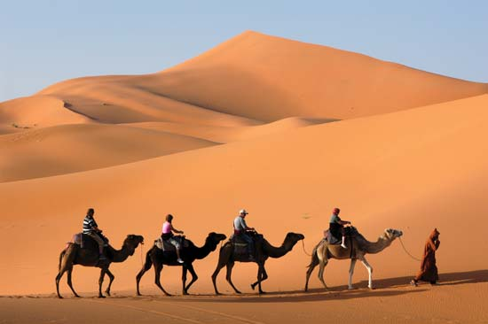

Slide 21
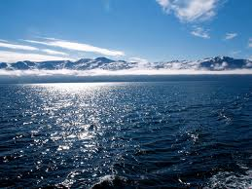
World Climates

