Slide 1
Map Essentials

Slide 2
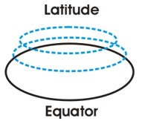
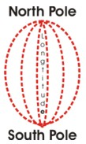
Latitude and Longitude
The earth is divided into lots of lines called latitude and longitude.

Slide 3
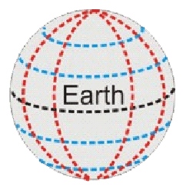
Lines
Longitude lines run north and south.
Latitude lines run east and west.
The lines measure distances in degrees.
Latitude
Longitude

Slide 4
Where is 0 degree?
The equator is 0 degree latitude.
It is an imaginary belt that runs halfway point between the North Pole and the South Pole.
Equator

Slide 5
Where is 0 degree?
P
R
I
M
E
M
E
R
I
D
I
A
N
The prime meridian is 0 degrees longitude. This imaginary line runs through the United Kingdom, France, Spain, western Africa, and Antarctica.

Slide 6
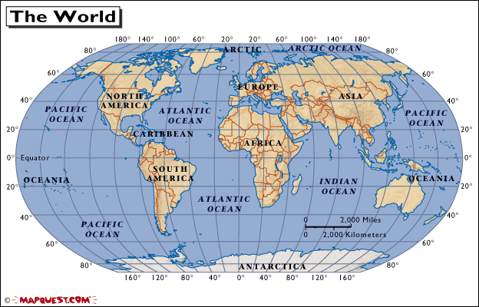
Australia

Slide 7
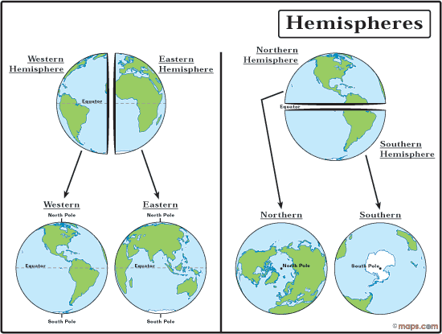

Slide 8
Hemispheres
By using the equator and prime meridian, we can divide the world into four hemispheres, north, south, east, and west.

Slide 9
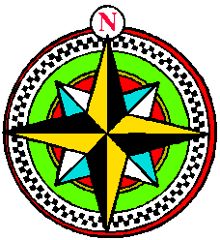
Compass
A compass is a tool that helps the user know what direction one is headed.
On a map, a compass or a compass rose helps the user locate these directions.

Slide 10
Compass Rose
The needle on a compass is magnetized to point to the earth's north magnetic pole. Thus with a compass, a person can roughly tell which direction they are headed.
There are four major or cardinal directions on a compass- north, south, east & west. In between are the directions northeast, northwest, southeast, southwest.
Source: http://aerocompass.larc.nasa.gov

Slide 11
Directions
The cardinal directions are north, south, east, and west.
The intermediate directions are northeast, southeast, southwest and northwest.
They help describe the location of places in relation to other places.

Slide 12
Scale
Maps are made to scale; that is, there is a direct connection between a unit of measurement on the map and the actual distance.
For example, each inch on the map represents one mile on Earth. So, a map of a town would show a mile-long strip of fast food joints and auto dealers in one inch.

Slide 13
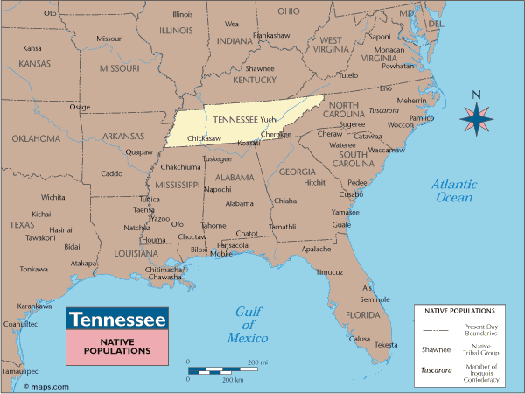
Scale

Slide 14
Time Zones
The Earth is divided into 24 time zones, corresponding to 24 hours in a day.
As the earth rotates, the sun shines in different areas, moving from east to west during the course of a day.
Places that have the same longitude will be in the same time zone.

Slide 15
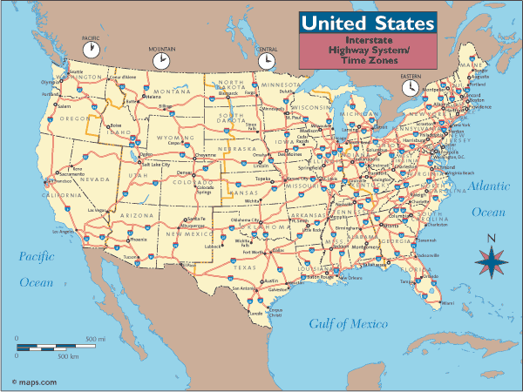

Slide 16
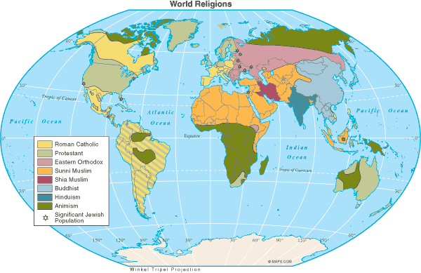
Map Legend (Key)
The legend is the key to unlocking the secrets of a map. Objects or colors in the legend represent something on the map.
Religions Legend

Slide 17
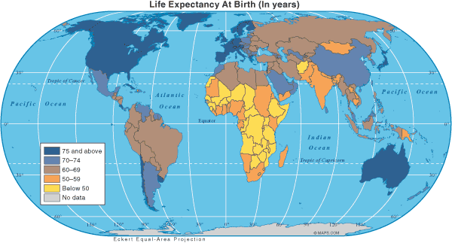
Life Expectancy
United States
China
India
Brazil
Legend/Key

Slide 18
This Week’s Video

Slide 19
Feel Good Video of the Week

Slide 20
Free Rice

