Slide 1
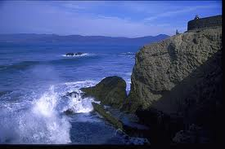
Fun Facts: Continents and Oceans

Slide 2
There are five main oceans in the world: The Arctic, The Atlantic, The Pacific, The Indian, and the Southern.
The northern most Ocean is the Arctic Ocean while the furthest ocean south is the Southern Ocean.
The Worlds oceans are made up of salt water.

Slide 3
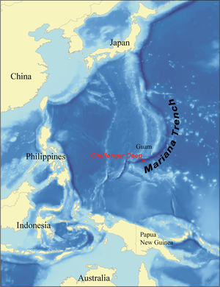
The deepest known point on Earths surface is located in the Pacific Ocean
This point is known as Challenger Deep and is nearly 7 miles deep.

Slide 4
The World’s oceans surround the continents on our planet.
The seven continents include: North America, South America, Europe, Asia, Africa, Australia, and Antarctica.
Asia is the largest Continent

Slide 5
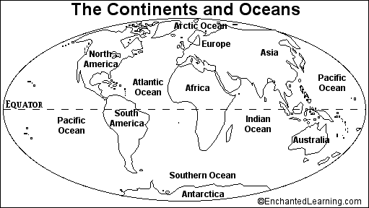

Slide 6
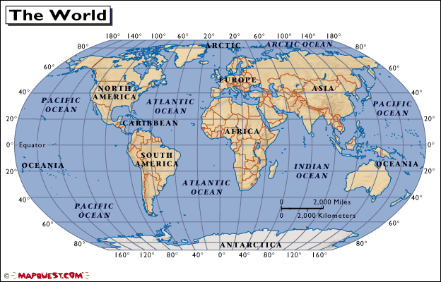

Slide 7
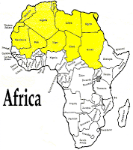
The Continent of Africa is home to the World’s third largest desert.
This desert is called the Sahara Desert. It is the hottest desert in the world and takes up an area as large as the country of China.

Slide 8
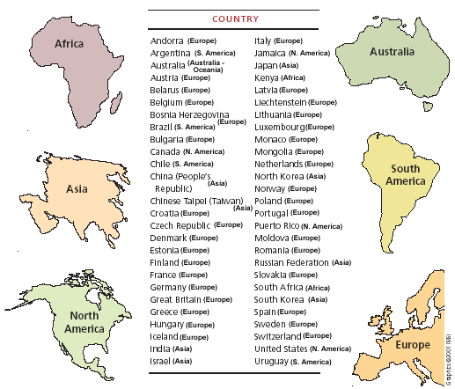

Slide 9
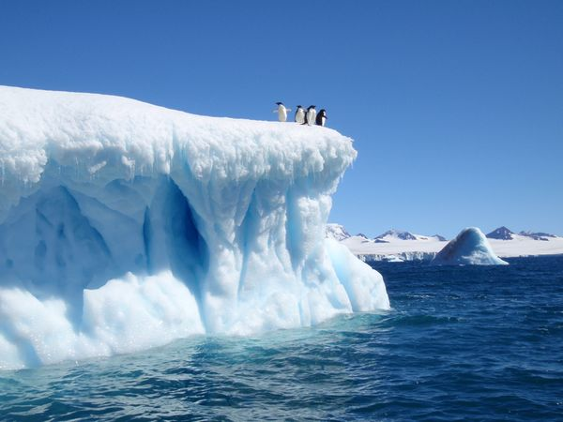
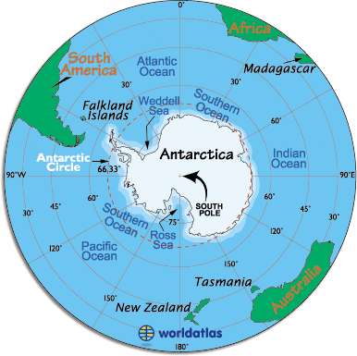
Antarctica is Earth’s southernmost continent
It is the coldest, driest, and windiest continent on the planet
98% of Antarctica is made up of ice and there are no permanent human residents

Slide 10
Even though Antarctica often appears very large on maps, it is actually the fifth largest continent on Earth
The coldest temperature on Earth was recorded here at -128.6 F. The temperature was taken at a Russian observation post.

