Slide 1
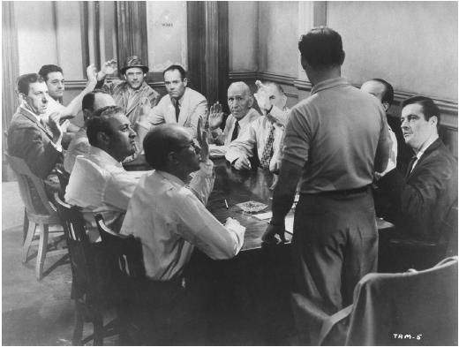
Juror 7
Juror 6
Juror 8
Juror 10
Juror 11
Juror 9
Juror 5
Juror 1
Juror 4
Juror 3
Juror 12
Juror 2

